Slide 1
Introduction to dataset collection
GitHub KEM292

Slide 2
Aim
Build a video and image dataset to train a code on discerning and recognizing visual cues during digestion of a gelatin gel.

Slide 3
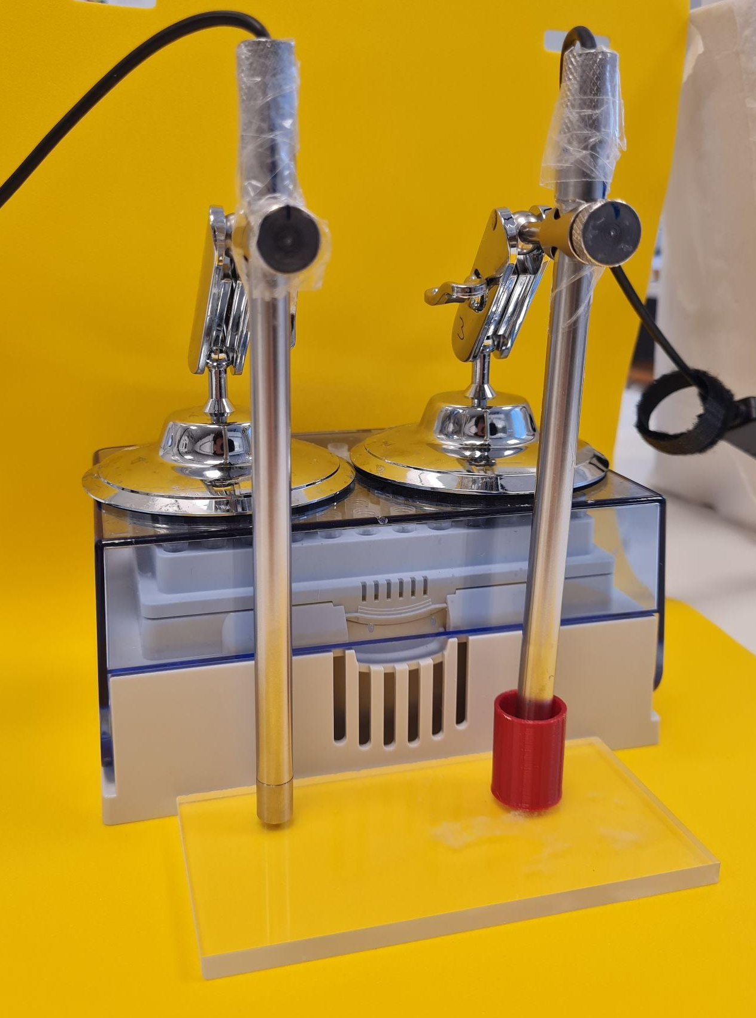
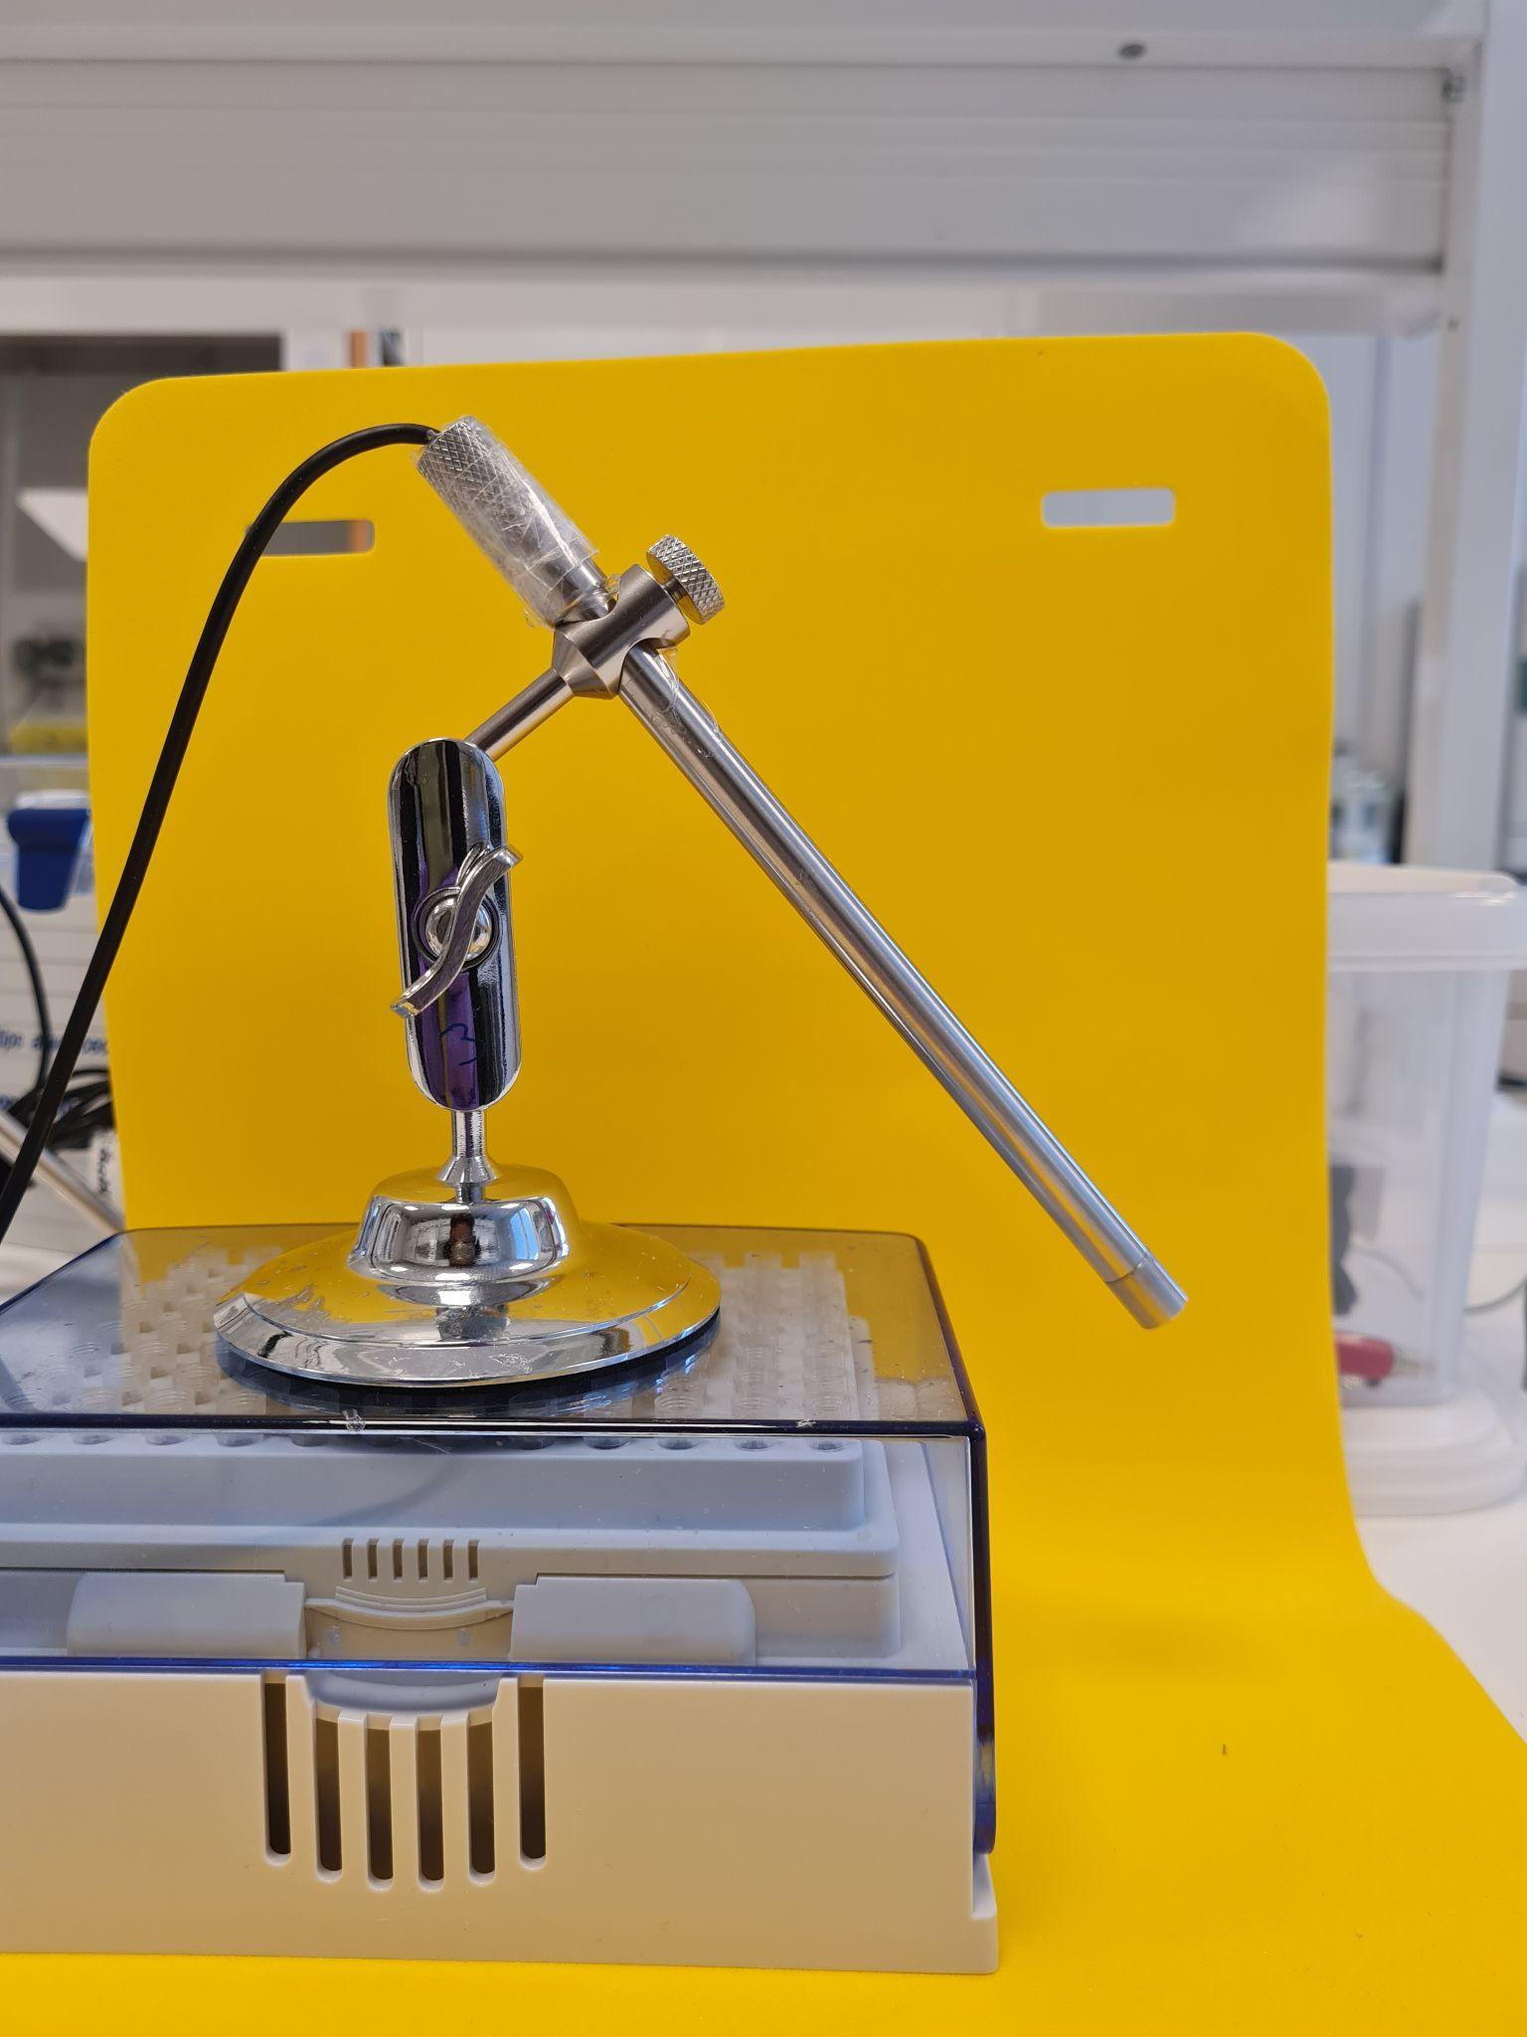
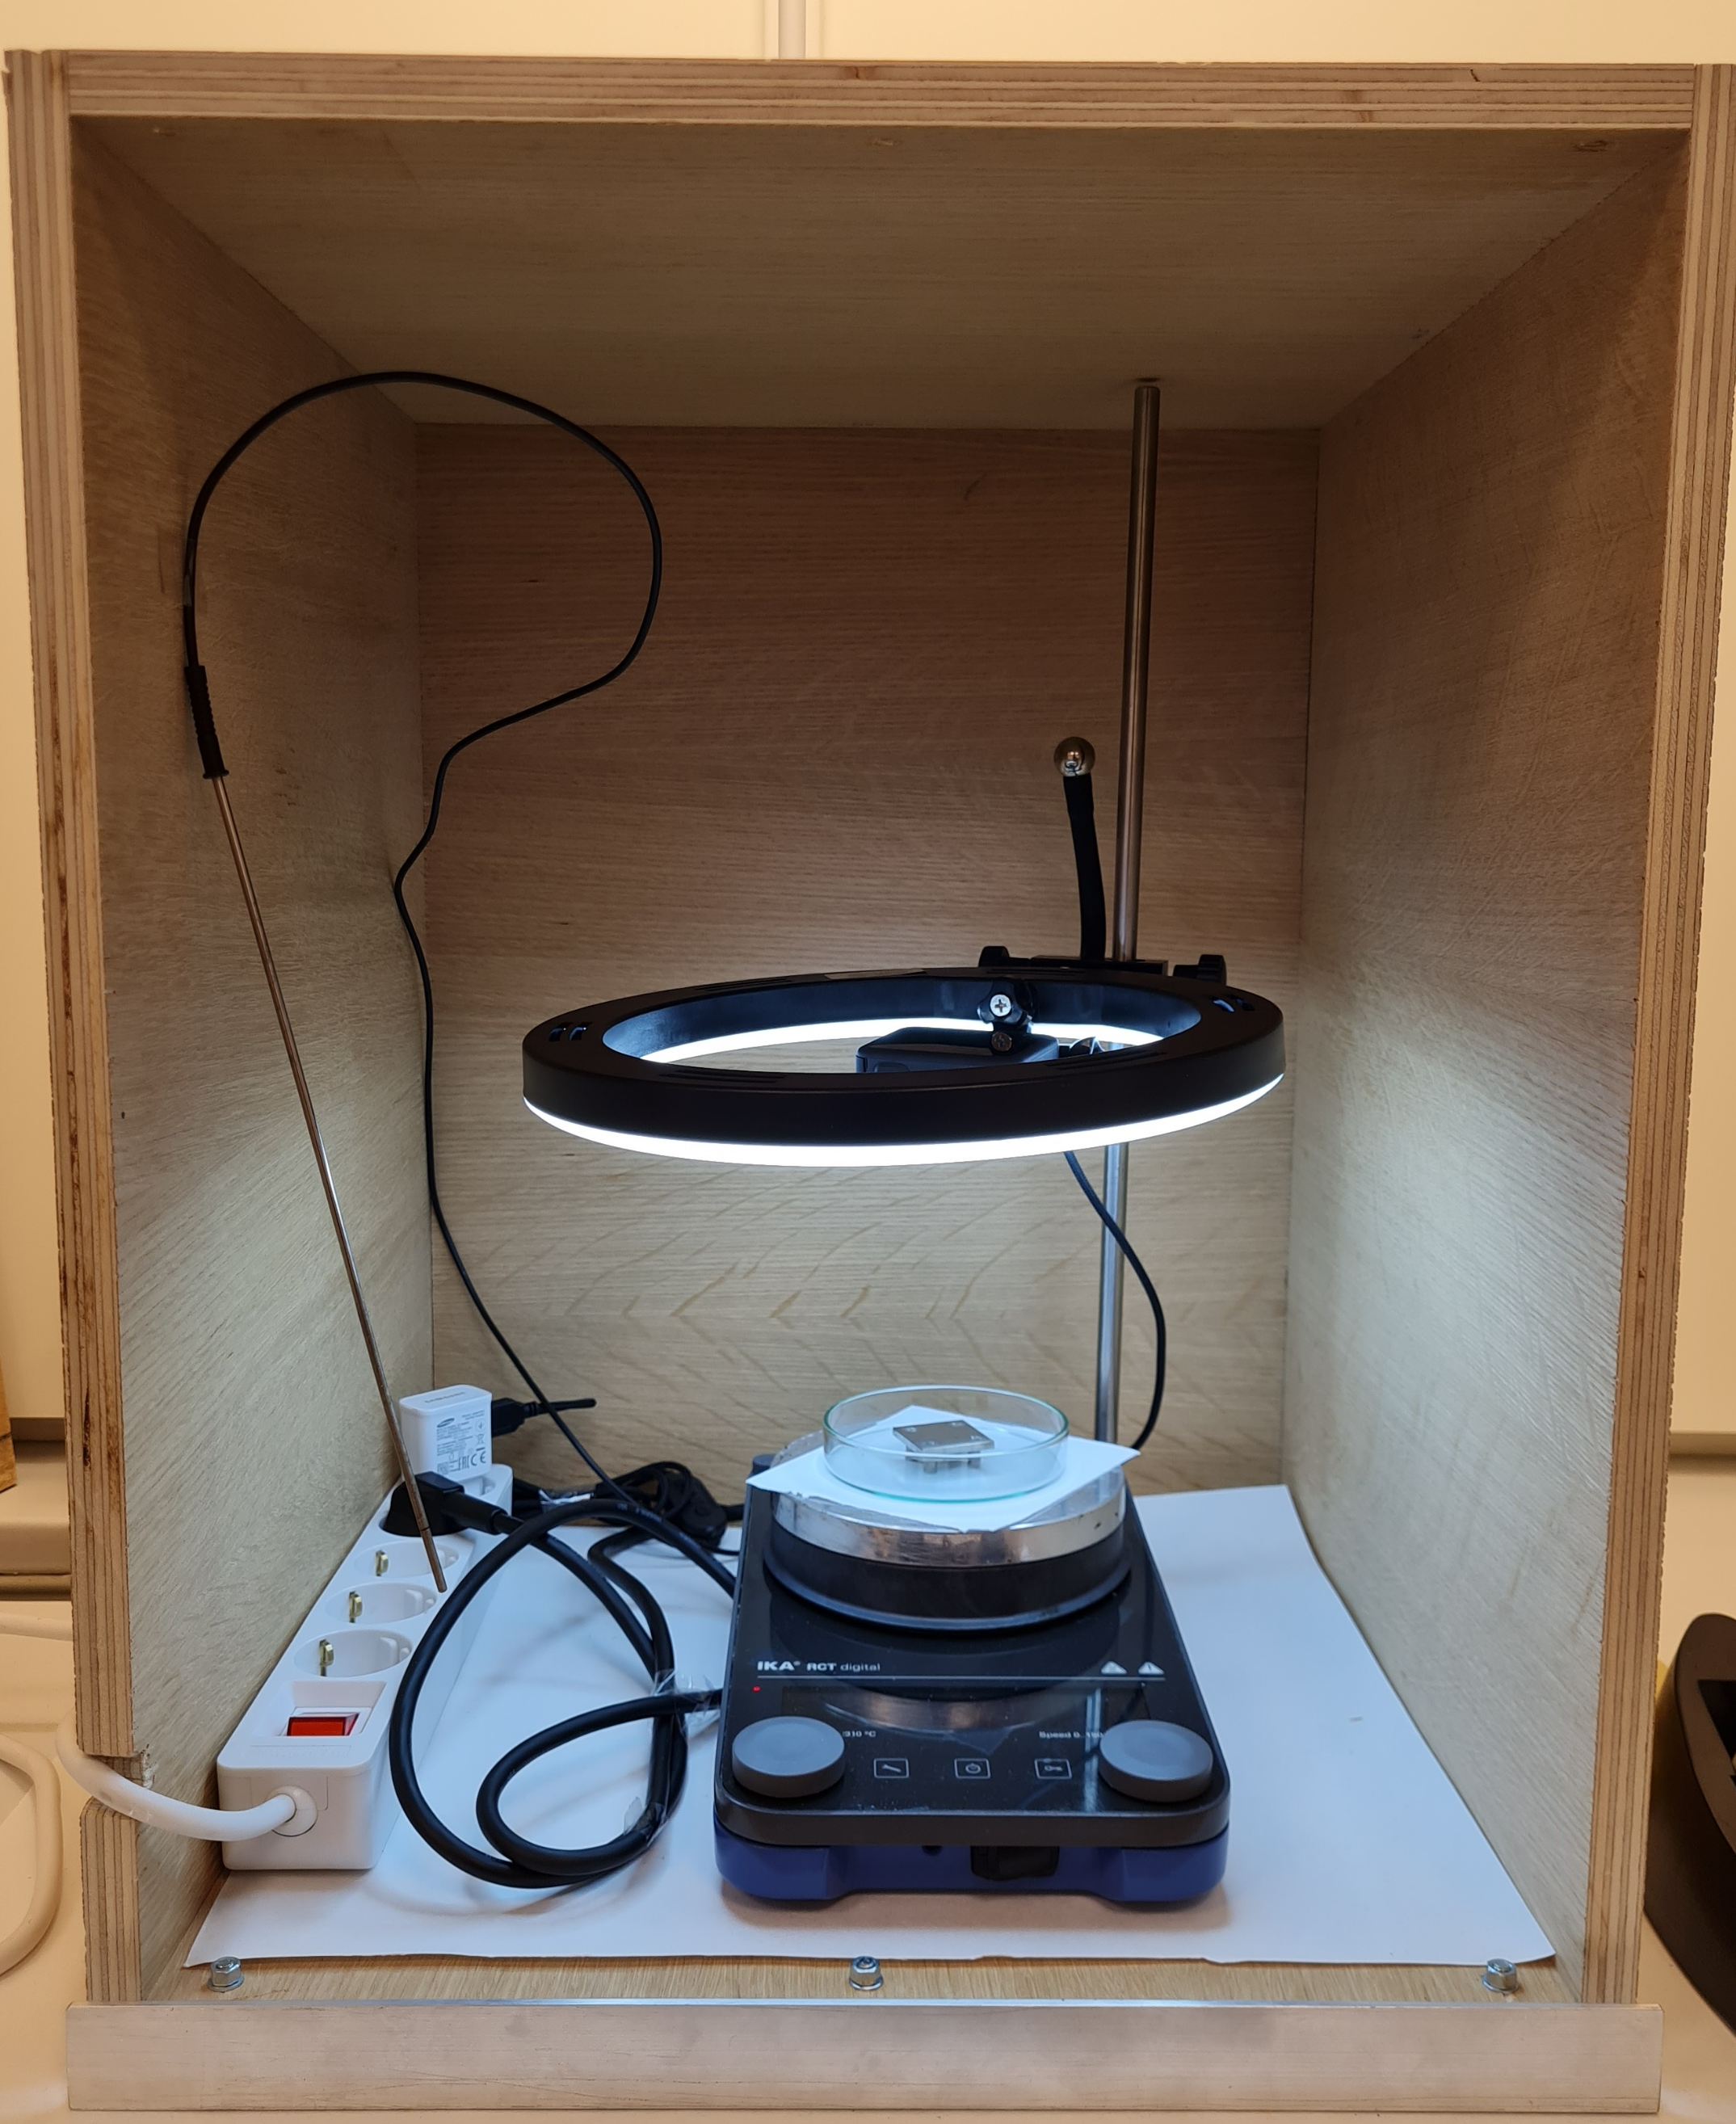
Gel casting
Microscope probe
Gel casted is a 3% w/V gelatin gel in ultra-pure water, crosslinked with TGM to make it resistant to body temperature (37⁰C) and with a yellow food dye to make it colored.
The video recordings for the dataset were collected using the microscope probe in the pictures on the left (https://www.amazon.se/Staright-Microscope-Inspection-Magnification-Smartphones/dp/B09FZ541PT?source=ps-sl-shoppingads-lpcontext&ref_=fplfs&psc=1&smid=A3D3WC8ILPB8DS)
Neutral booth where we recorded the videos with the closed box

Slide 4





Gel Casting Conditions
65 µl TGase is added
100 µl yellow food colouring
30 min
10 min
40 min
10 min
Gelatin swelling
3 % m/V
Gel casting
Warming gelatin
45°C
TGase crosslinking
45°C
TGase deactivation
80°C
Notes:
Gelatin Type A (Bloom 300 g, porcine skin, Sigma-Aldrich)
TGase (Galaya® Prime, Novozyme)
yellow food colouring (Dr.Oetker)

Slide 5
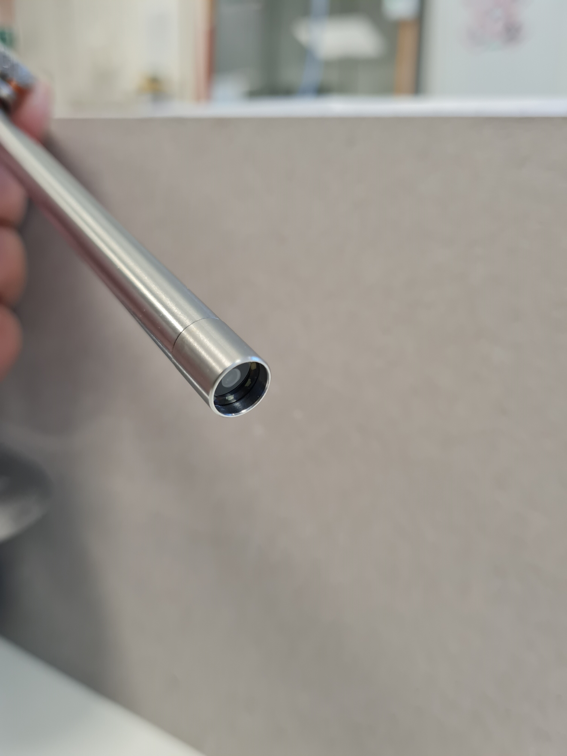
Gel casting The gel was casted in slightly different ways on the microscope probe
With a straw
Without a straw
Using a plastic straw to deposit 0.8 cm-think gel in front of the microscope camera
Just depositing 0.2 cm-thick gel in the concavity in front of the microscope camera
Named “…_with_straw_...”
Used mostly in the old setup during July and August, but no more in the new setup
Named “…_without_straw_...”
Used in the “new setup” and with a better outcome

Slide 6
Setups - Put in a water bath with different media conditions (pH, IS, presence of pepsin). - The neutral booth setup was employed to avoid any lighting difference coming from the room. - Connect the camera to a computer with OBS (Open Broadcaster Software). - Recorded it for 10 hours.
July folder
With a straw
A trial period to get to chose the best setup. Some video has the probe completely enveloped in gel, some other with a straw but a layer of air in between the camera and the gel.
Check it out, but it is worth to check the rest more
Especially in August the straw setup (check previous slide) has been employed, but it was missing a white paper below the water bath (to avoid reflection from the heating plate) and OBS was set to autoexposure, which automatically changed the exposure value in the recorded video.
With a straw
Best setup, with a white paper below the water bath (to avoid reflection from the heating plate) and OBS was set to manual exposure, which kept the same exposure value throughout the whole recording

Slide 7
Dataset criteria pH (obtained with NaOH or HCl) and ionic strength (obtained with NaCl) to mimic stomach and intestinal conditions
Acronym | pH | Ionic Strength or IS (mM) | Pepsin
pH 3 IS 0 | 3 | 0 | -
pH 3 IS S | 3 | S | -
pH 3 IS I | 3 | I | -
pH 3 IS S pepsin | 3 | S | yes
pH 7 IS 0 | 7 | 0 | -
pH 7 IS S | 7 | S | -
pH 7 IS I | 7 | I | -
S = Stomach = 98 mM
I = Intestinal = 142 mM

Slide 8
Data Analysis done by Julia so far
For each recording - run a timelapse script that keeps every 200th frame of the recording
For each timelapse video (around 3 minutes), average grayscale values are calculated over time. Linear regression is performed on the data and plots showing the grayscale trend for each video are generated

